Slide 1



Attribution Dashboard
View in Power BI
Last data refresh:
5/12/2024 4:30:42 PM UTC
Downloaded at:
5/14/2024 2:52:56 PM UTC

Slide 2
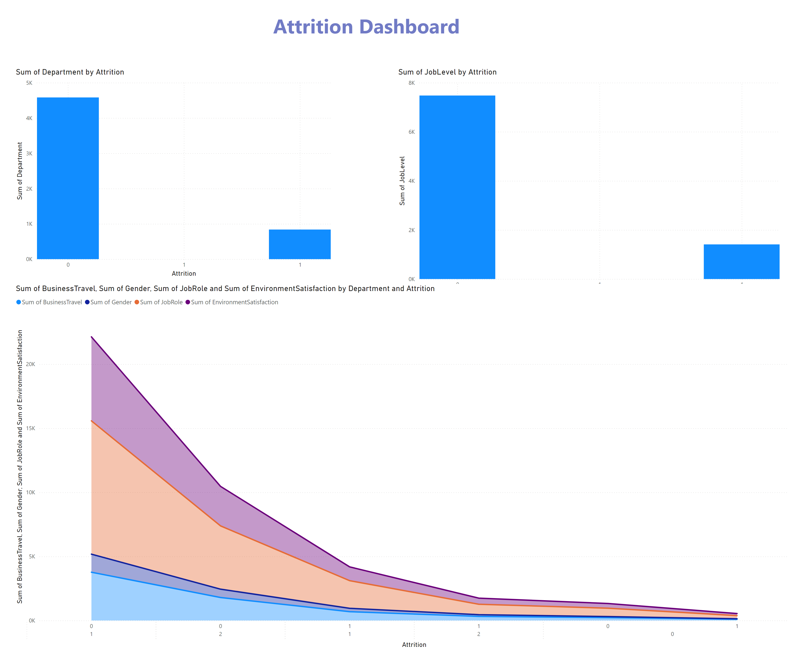
Page 1
Notes:
textbox
No alt text provided
columnChart
No alt text provided
columnChart
No alt text provided
stackedAreaChart
No alt text provided

Slide 3
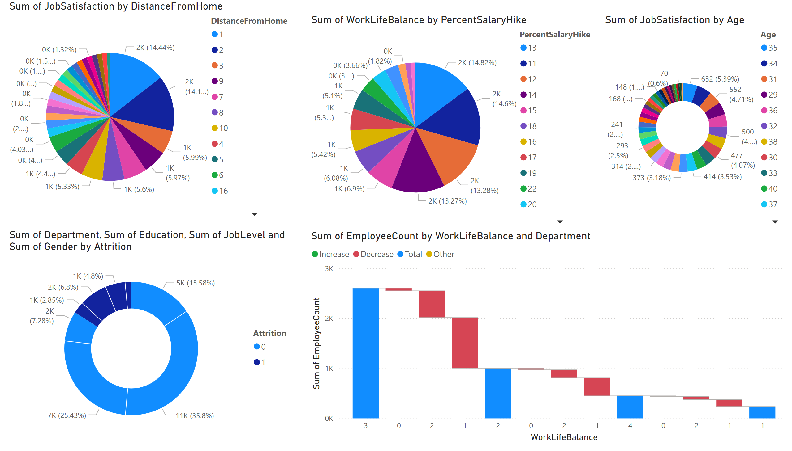
Page 2
Notes:
pieChart
No alt text provided
pieChart
No alt text provided
donutChart
No alt text provided
waterfallChart
No alt text provided
donutChart
No alt text provided

Slide 4
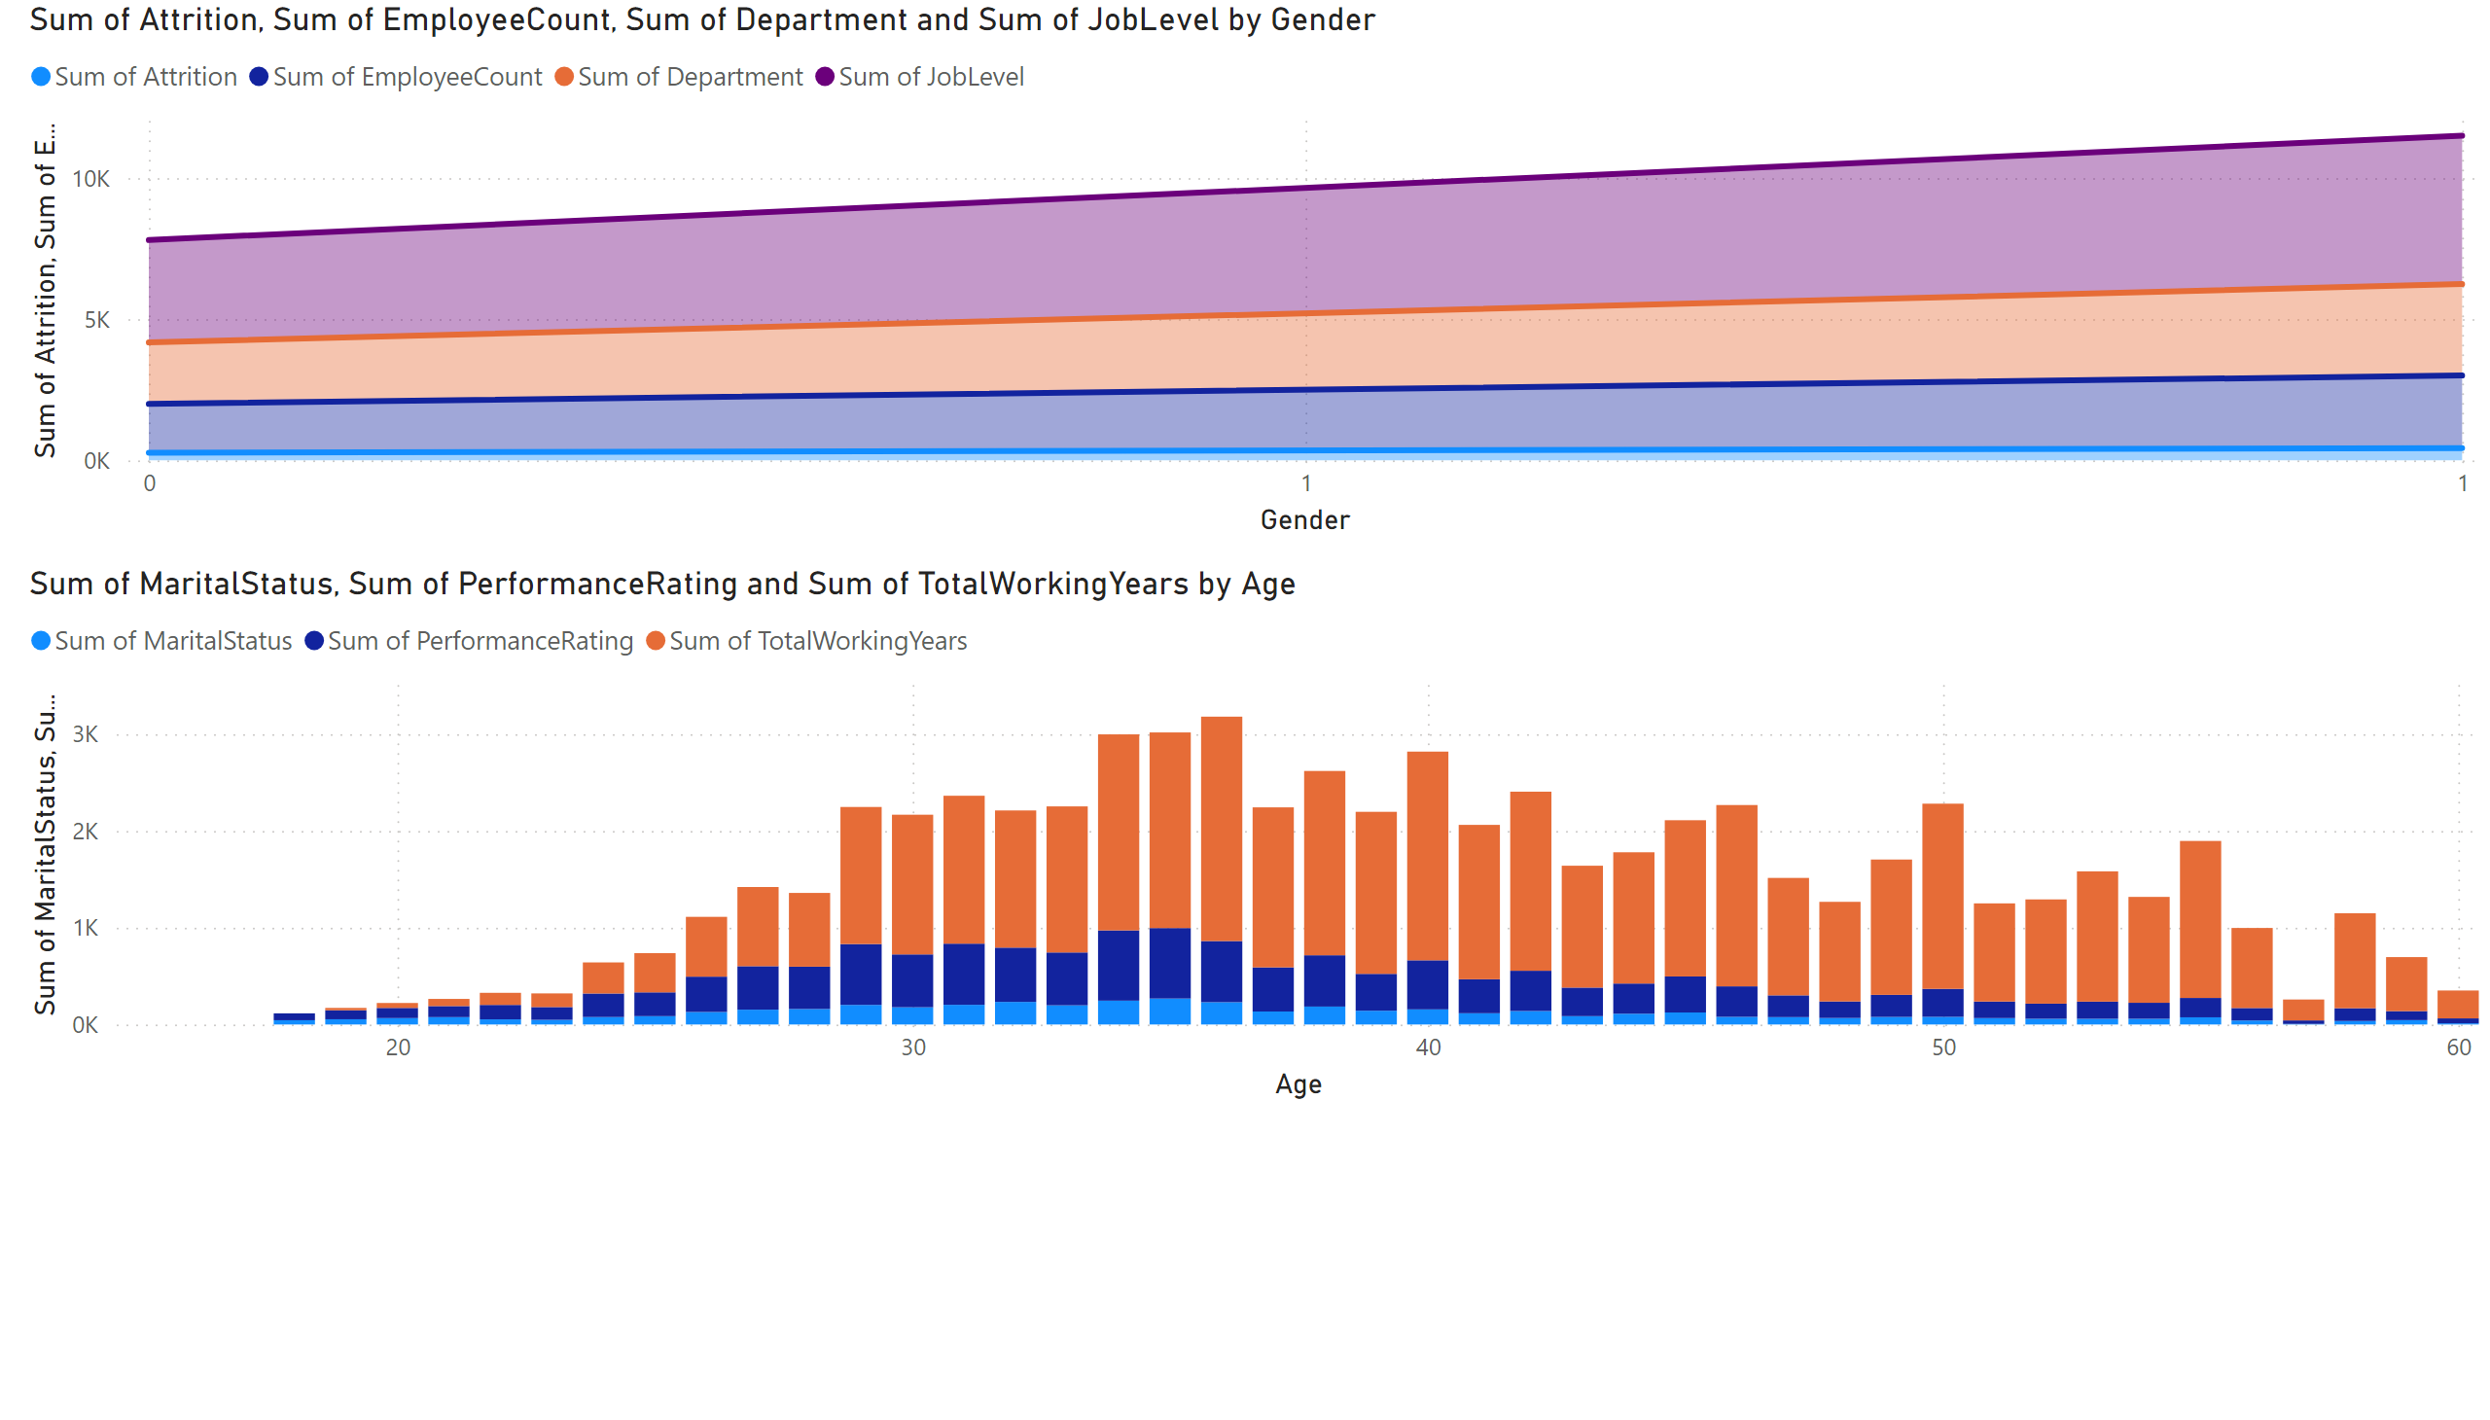
Page 3
Notes:
lineStackedColumnComboChart
No alt text provided
stackedAreaChart
No alt text provided

Slide 5
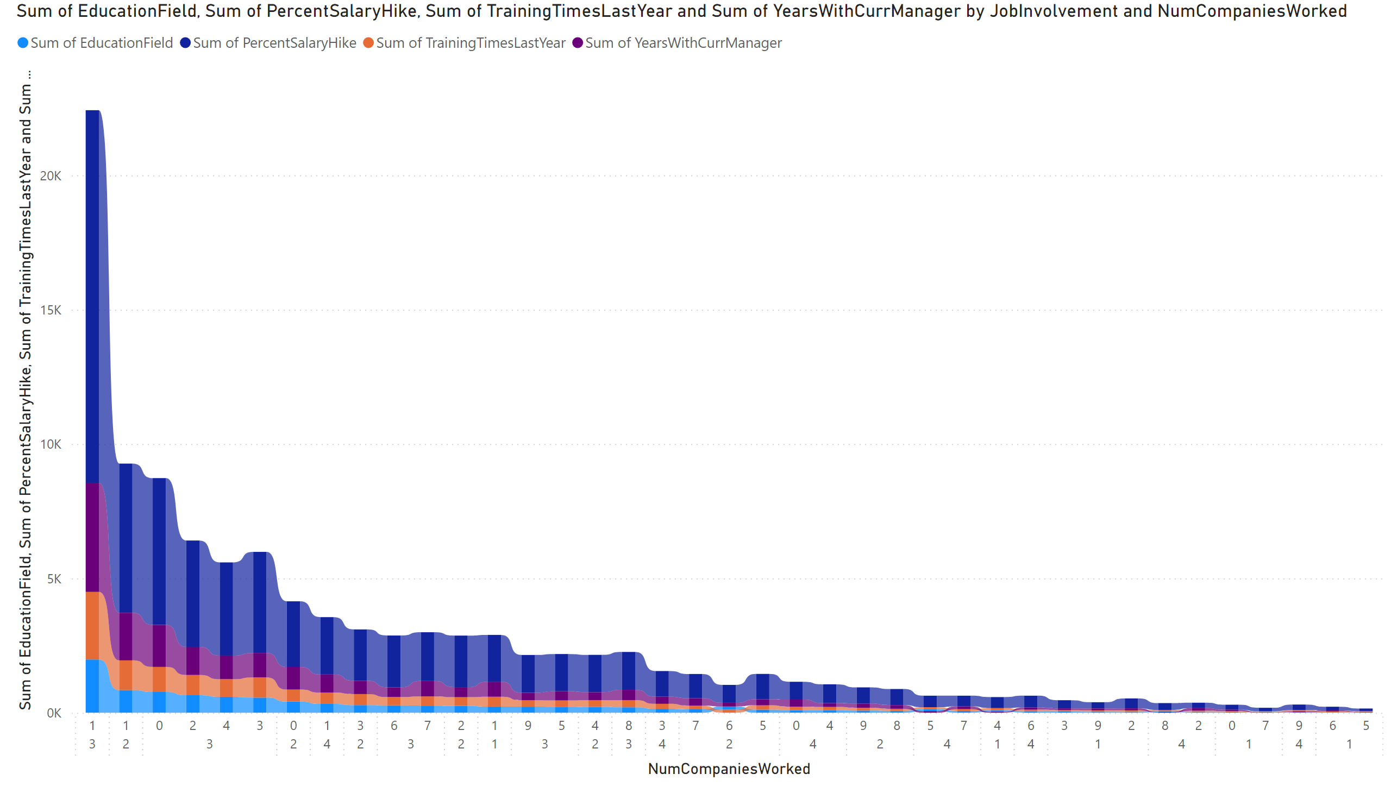
Page 4
Notes:
ribbonChart
No alt text provided

